Slide 1


RV32IM 5-STAGE PIPELINE RISC-V PROCESSOR.
Name
M. Umair Ajmal

Slide 2

Problem Statement
Traditional single-cycle processors execute one instruction per cycle but suffer from long clock cycles and low throughput.
As instruction complexity increases, performance bottlenecks appear in single-cycle architectures.
Idle hardware units during execution lead to inefficient resource utilization.
Modern applications require higher instruction throughput without increasing clock frequency.
Need for a pipelined processor design to improve performance while maintaining correctness.
Hazard handling (data and control hazards) becomes essential for stable pipelined execution.

Slide 3

Abstract
Designed and implemented a 5-Stage Pipelined RISC-V (RV32IM) Processor .
Developed using System Verilog. .
Utilized Xilinx Vivado for design, simulation, and synthesis.
Processor divided into five stages: IF, ID, EX, MEM, and WB.
Achieves instruction-level parallelism and higher throughput than single-cycle architecture.
Integrated pipeline registers, forwarding logic, and hazard detection for smooth execution.
Supports all RV32IM instruction types (R, I, S, B, U, J).
Successfully verified through simulation ensuring correct execution and performance improvement.

Slide 4
Project Objectives
Design and implement a 5-stage pipelined RISC-V (RV32IM) processor .
Achieve higher instruction throughput compared to single-cycle architecture.
Integrate pipeline registers for parallel instruction execution.
Ensure correct control signal synchronization across all stages.
Implement forwarding and hazard detection units to handle data/control hazards.
Verify functionality through simulation.

Slide 5

Tools & Technologies
Software
Xilinx Vivado (Design, Simulation, Synthesis)
SystemVerilog (HDL for all modules)

Slide 6

Key Features
5-stage pipelined architecture (IF, ID, EX, MEM, WB)
Enables instruction-level parallelism for higher throughput
Pipeline registers for inter-stage data synchronization
Forwarding logic to resolve data hazards efficiently
Hazard detection unit for stall and flush control
Supports complete RV32IM instruction set (R, I, S, B, U, J)
Synchronized control signals across all stages
Achieves 3×–5× performance improvement over single-cycle
Modular, reusable SystemVerilog design

Slide 7

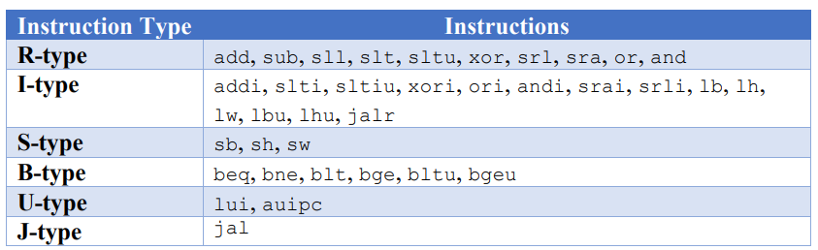
RISC-V ISA Overview
Open-source and modular instruction set architecture
Project targets RV32IM (Base Integer + Multiplier Extension)
Designed for simplicity, scalability, and educational use

Slide 8
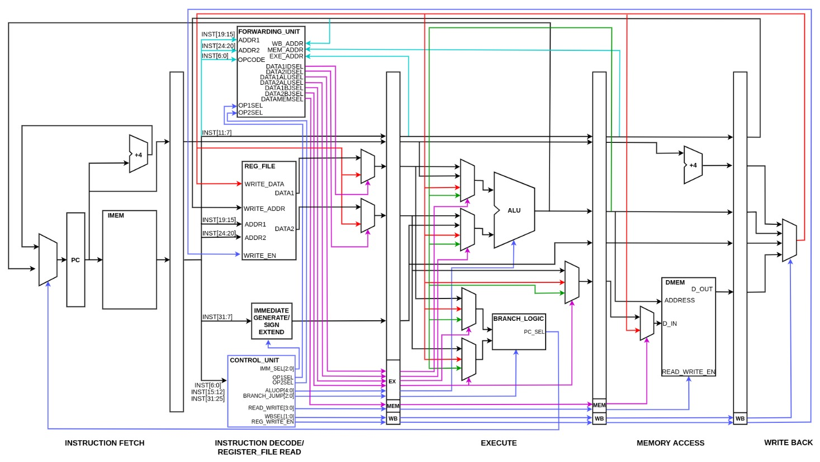
System Architecture

Slide 9
Instruction Execution Stages:
Fetch – Get instruction from memory
Decode – Parse opcode, registers, immediate
Execute – Perform ALU or address calculation
Memory Access – Load/store operations
Write Back – Store result in register

Slide 10




Pipelining Analogy
Without Pipelining
With Pipelining

Slide 11
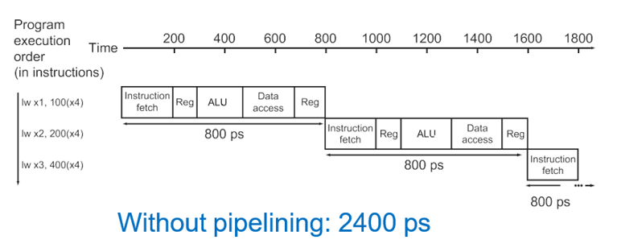
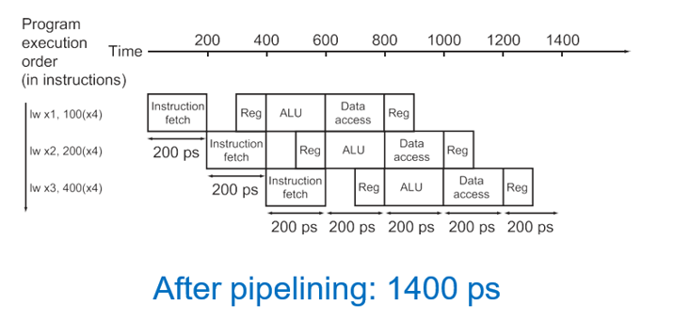
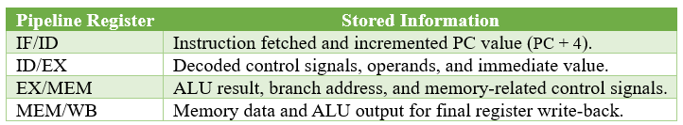
Pipelining in Instructions

Slide 12
Key Components
Program Counter (PC) Holds current instruction address.
Instruction Memory
Stores and provides program instructions.
Register File
Holds 32 general-purpose registers.
Immediate Generator Extracts and sign-extends immediate values.
ALU (Arithmetic Logic Unit) Performs arithmetic and logical operations.
Control Unit
Generates control signals for all stages.
Branch Comparator Evaluates branch conditions.
Multiplexers (MUX)
Select between multiple input data paths.
Pipeline Registers
Store intermediate data/control between stages.
Forwarding Unit
Resolves data hazards by bypassing.
Hazard Detection Unit Detects and controls pipeline stalls/flushes.
Data Memory
Handles load and store operations.

Slide 13

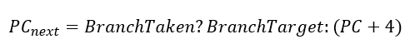
Program Counter (PC)
Holds the address of the current instruction
Updates every clock cycle (PC + 4 or branch/jump target)
Drives instruction fetch from memory
Handles both sequential flow and control transfers

Slide 14
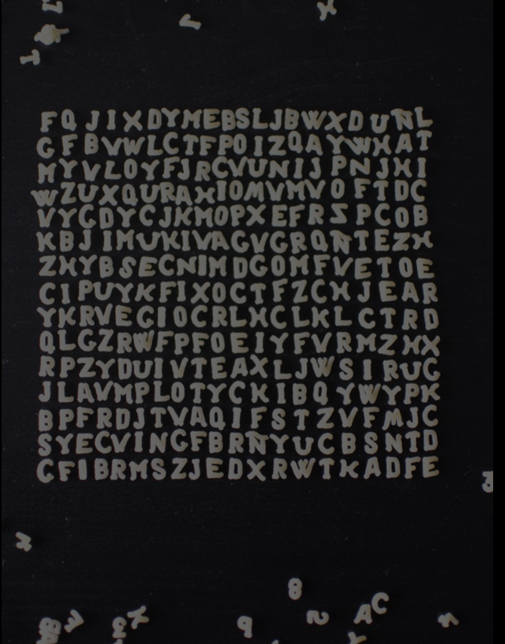
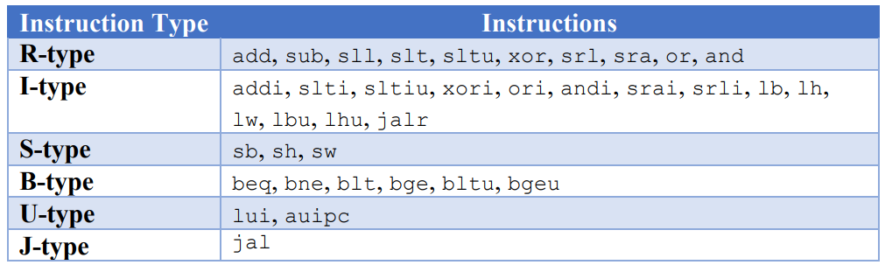
Instruction Memory
Stores all program instructions in machine code
Read-only memory accessed using PC value
Returns a 32-bit instruction each cycle
Preloaded from instructions.mem file

Slide 15

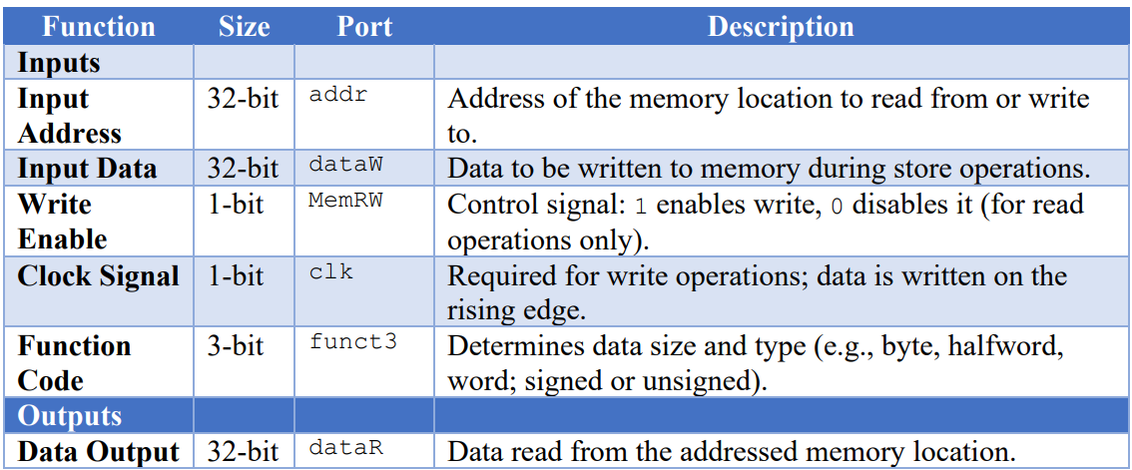
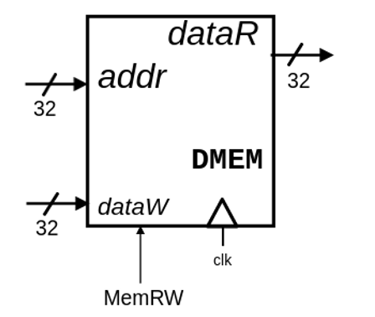
Data Memory

Slide 16
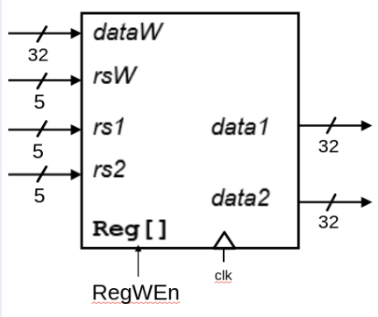
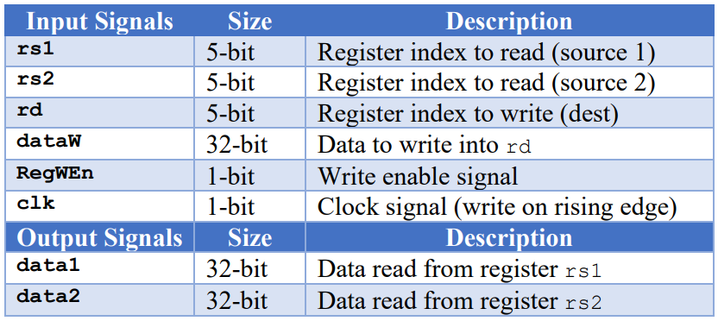
Register File
Contains 32 general-purpose 32-bit registers (x0–x31)
Supports 2 reads and 1 write per clock cycle
Register x0 is hardwired to zero
Preloaded from reg_init.mem during simulation

Slide 17

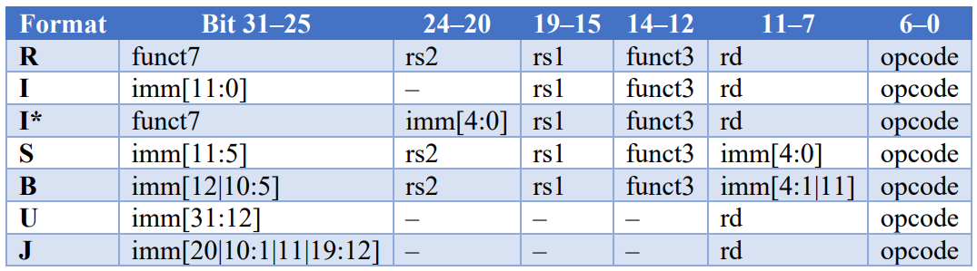
Immediate Generator
Extracts immediate values from instruction fields
Supports all formats: I, S, B, U, J
Performs sign-extension to 32 bits
Output used by ALU, branch logic, and memory access

Slide 18
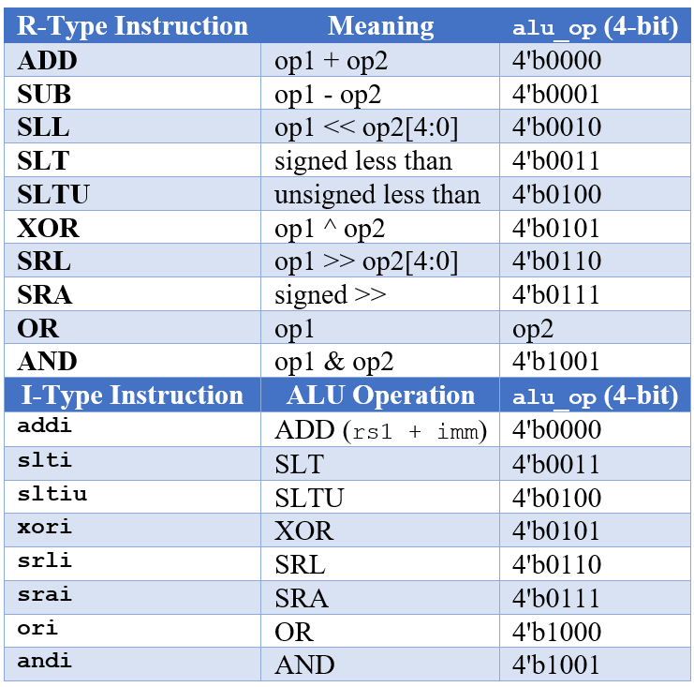
ALU (Arithmetic Logic Unit)
Executes arithmetic and logical operations
Takes two operands: from registers or immediate
Controlled by 4-bit ALU control signal
Includes hardware for Integer Multiplication and Division
Executes mul, mulh, mulhsu, div, divu, rem and remu due to M extension.

Slide 19
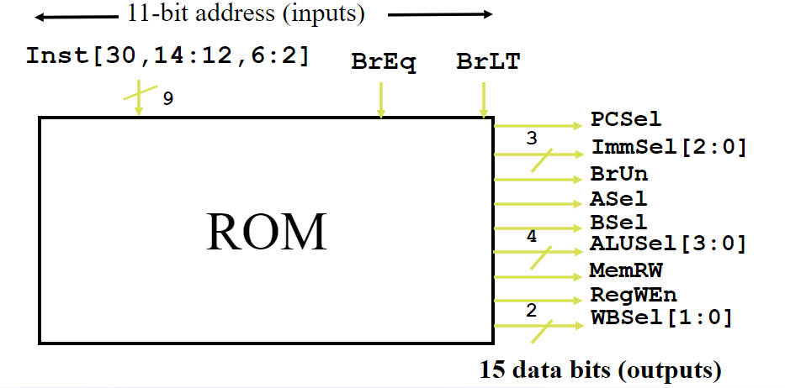
Control Unit
Decodes instruction opcode to generate control signals
Controls modules like ALU, memory, MUXs, and register file
Drives data path and control path behavior
Decodes funct7(0000001) to identify M-extension Instruction.

Slide 20

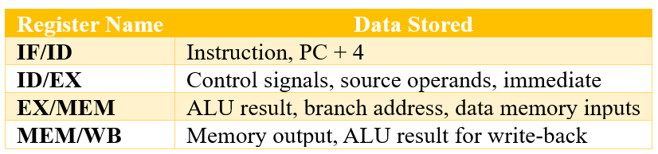
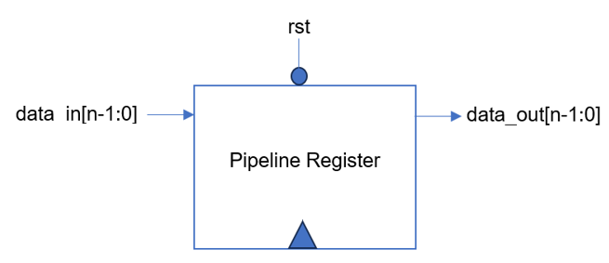
Pipelined Registers
There are four pipeline register modules (IF/ID, ID/EX, EX/MEM, MEM/WB).
Each stores intermediate data and control signals between consecutive stages.

Slide 21
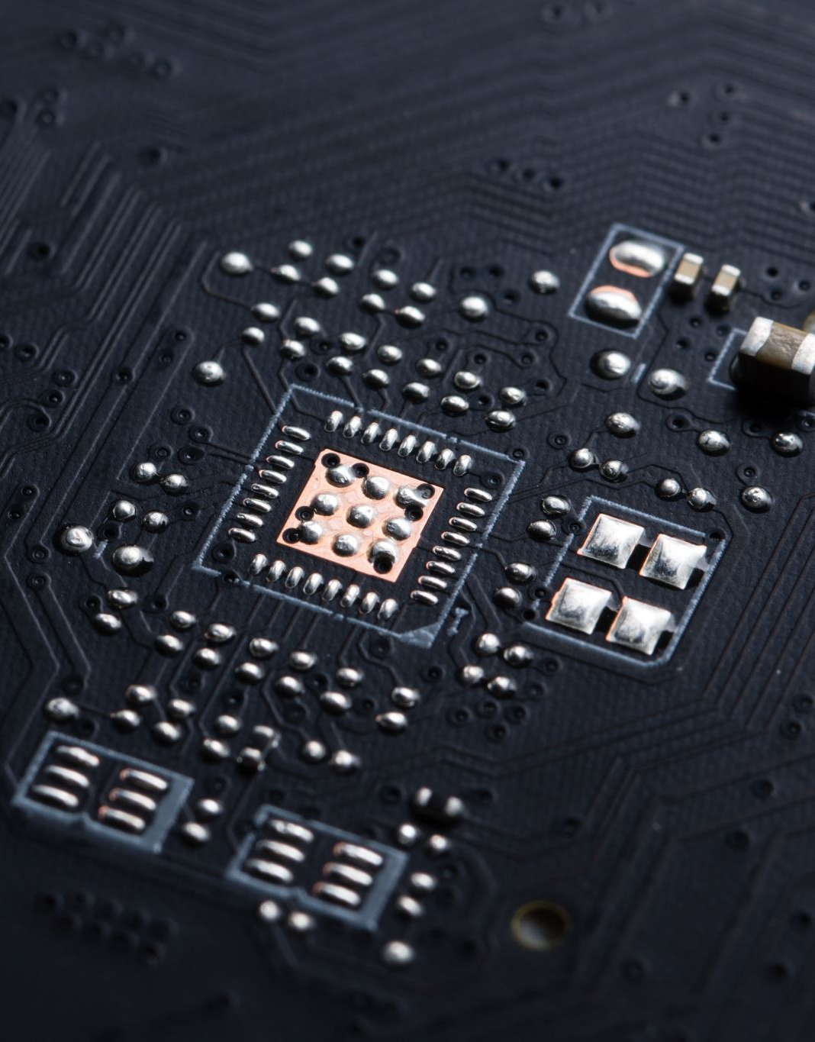
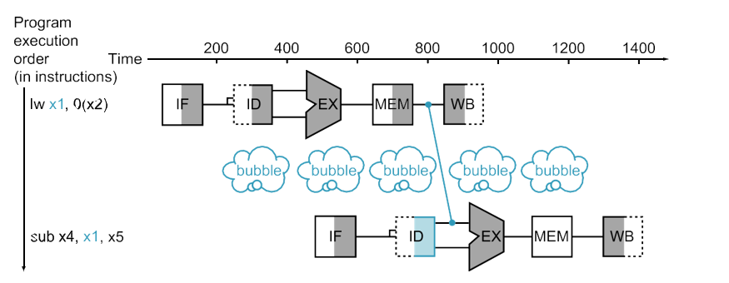
Hazard Detection Unit
Detects data and control hazards during instruction execution.
Inserts pipeline stalls when forwarding is not possible (e.g., load-use hazards).
Initiates pipeline flush on branch mispredictions to maintain correct flow.
Handles Execution stalls for multi-cycle division operation , in addition to standard load-use stalls.

Slide 22
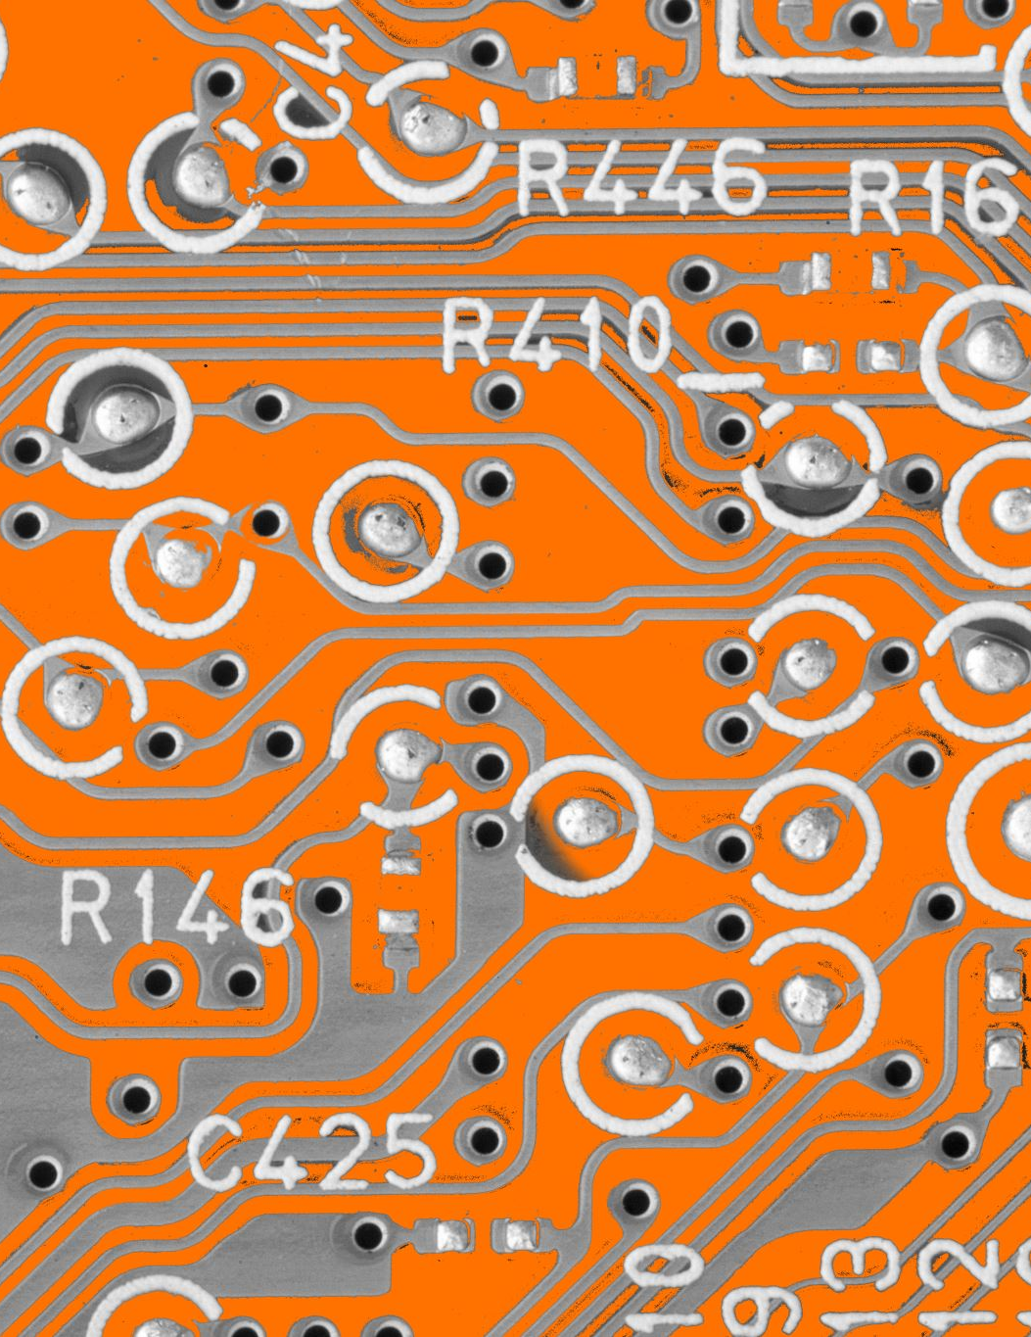
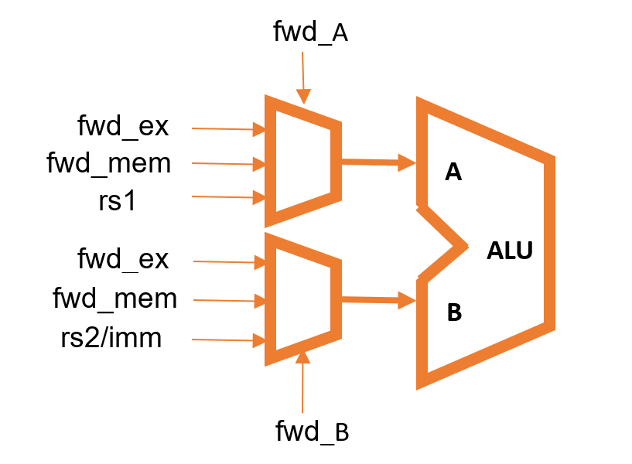
Forwarding Unit
Resolves data hazards by bypassing results from later stages to earlier ones.
Forwards data from EX/MEM or MEM/WB directly to the ALU inputs.
Minimizes pipeline stalls, improving overall instruction throughput.
Ensures correct operand values are available without waiting for write-back.

Slide 23
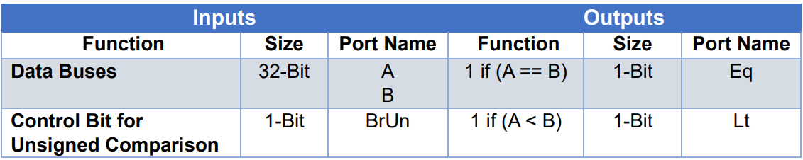
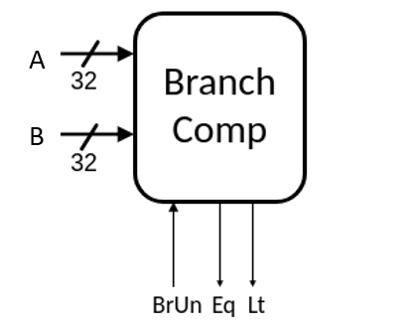
Branch Comparator
Compares two register values for branch decisions
Supports signed and unsigned comparisons
Guides PC update for instructions like beq, bne, blt, bge

Slide 24
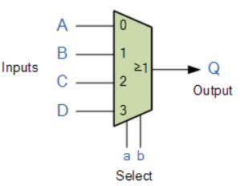
Multiplexers
Select between multiple inputs based on control signals
Choose between register or immediate for ALU input
Select ALU result or memory data for write-back
Decide next PC (sequential or branch/jump target)
Controlled by signals like ASel, BSel, WBSel, PCSel

Slide 25
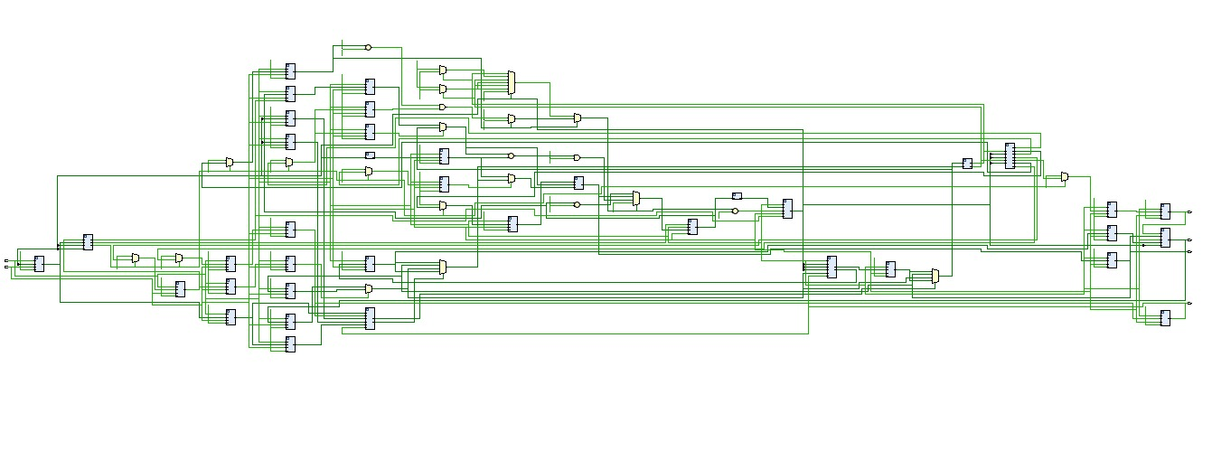
Top Module
Integrates all submodules (PC, ALU, Control Unit, Memories, etc.)
Manages signal routing across the entire processor
Controls program execution flow using PC updates and instruction decoding
Acts as the main system wrapper for simulation and synthesis

Slide 26
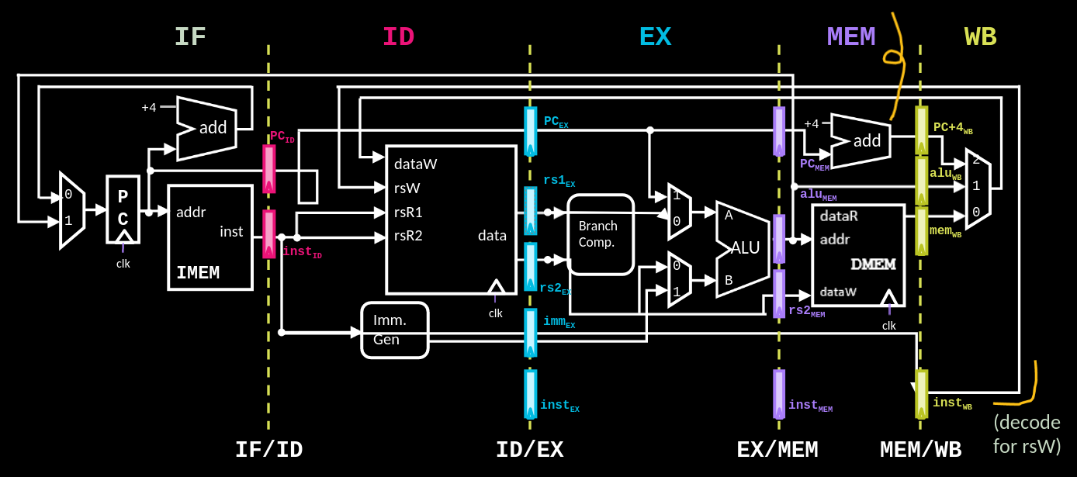
Datapath

Slide 27
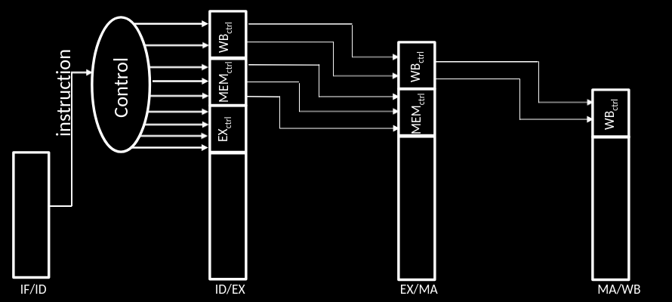
Control Path

Slide 28

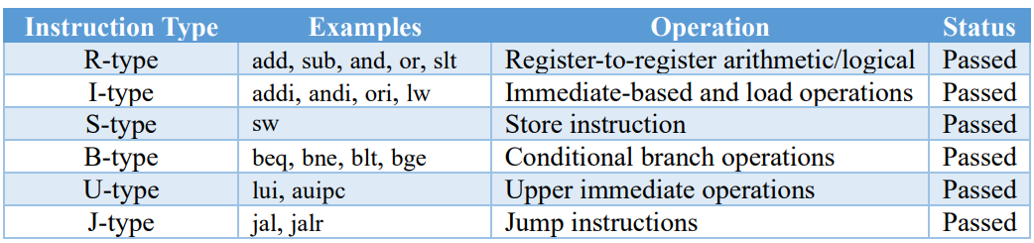
Testing
The following categories of RISC-V instructions were tested along with M type instructions.
Each instruction was validated by checking:
ALU result correctness
Register file updates
Branch decisions and PC updates
Data memory read/write behavior

Slide 29
Results
Verified functionality through module-level and system-level simulations.
Used .mem and assembly test programs to validate execution flow.
Confirmed correct ALU operations, branch decisions, and data memory behavior.
Forwarding and hazard detection units successfully handled data dependencies.
Throughput improved significantly compared to single-cycle design.

Slide 30
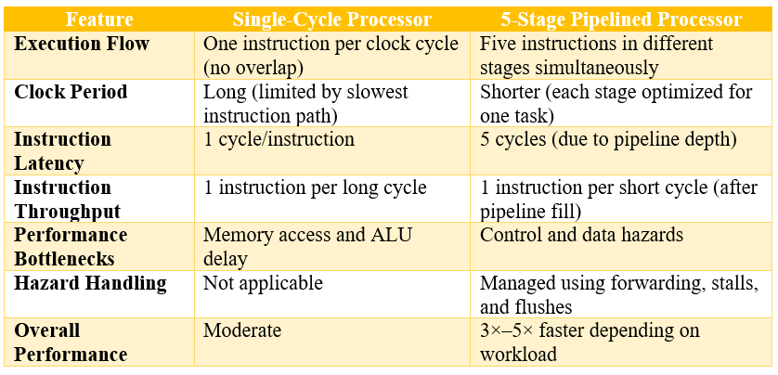
Performance Comparison

Slide 31
Source Code Directory
Sub-Folders | Files
Mem Files | Mem_generator.py, data_mem.mem, instructions.mem, reg_init.mem, reg_out.mem
RISC-V Instructions | Instructions.asm, Test_Instructions.asm
RTL Code | alu_logic.sv, branch_comp.sv, control_unit.sv, data_mem.sv, fwd_logic.sv, hazard_detection.sv, imm_gen.sv, inst_mem.sv, pipe_reg.sv, program_counter.sv, reg_file.sv, top.sv
Testbenches | alu_logic_tb.sv, branch_comp_tb.sv, control_unit_tb.sv, data_mem_tb.sv, fwd_logic_tb.sv, hazard_detection_tb.sv, imm_gen_tb.sv, inst_mem_tb.sv, pipe_reg_tb.sv, program_counter_tb.sv, reg_file_tb.sv, top_tb.sv

Slide 32
Conclusion
Successfully designed and implemented a 5-stage pipelined RISC-V (RV32IM) processor .
Achieved higher instruction throughput through instruction-level parallelism.
Integrated forwarding and hazard detection units for smooth pipeline execution.
Verified correct functionality using simulation.
Demonstrated clear performance improvement over single-cycle architecture.
Provides a strong foundation for advanced RISC-V microarchitecture development.

Slide 33
Future Improvements
Branch Prediction Add a branch prediction unit to reduce control hazard penalties.
Cache Integration Implement instruction and data caches to minimize memory latency.
Out-of-Order Execution Explore out-of-order execution for further performance gains.
RISC-V Extensions Extend the ISA with other RISC-V extensions (e.g., F, CSR).
Hardware Debug Interface Implement UART or LED-based debugging and I/O
Performance Optimization Optimize resource utilization for higher clock frequencies and scalability.

Slide 34

Thank You

